Slide 1
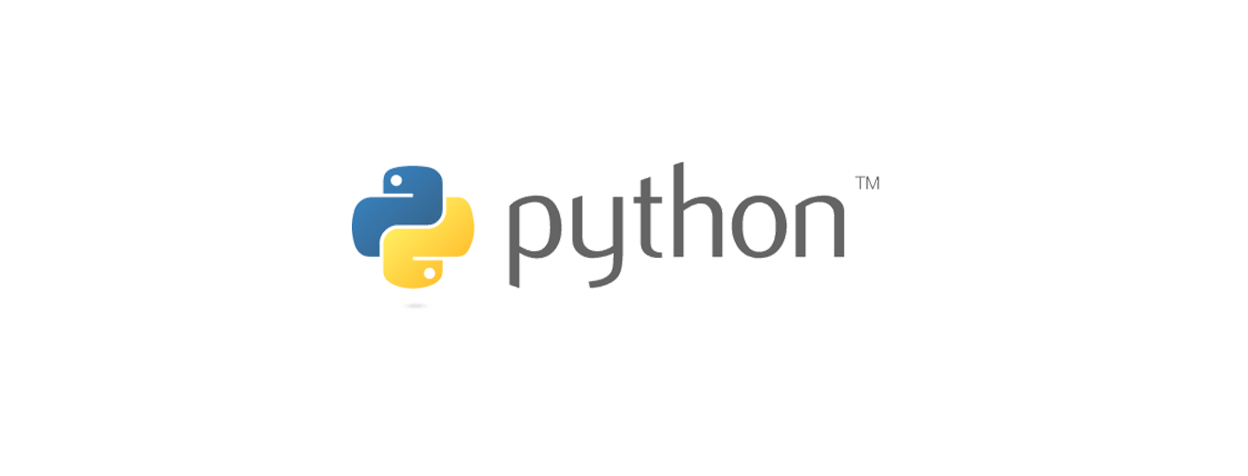
Python Programming Language
The heritage, Philosophy, platforms, characteristics, strengths, and weaknesses
Presentation by Alex Herbert

Slide 2
Heritage and Philosophy
The creator of Pyhton is Guido van Rossum, he developed Python in the late 1980s, with the first release of the language in 1991.
The philosophy of Python is:
Readability and Simplicity, Emphasizing clear and concise code.
Explicit over Implicit, Follows the Zen of Python principles, promoting explicit coding practices.
Versatility, Supports multiple programming paradigms – procedural, object-oriented, and functional
Python was inspired by languages like ABC, Modula-3, and C.

Slide 3
Platforms for development and running python applications
Python is cross-platform compatible and runs on Windows, macOS, and Linux.
Development Environments include:
PyCharm
Visual Studio Code
Eclipse with PyDev
Text Editors such as Atom, Notepad++ and Sublime Text
Execution Environments include:
Virtual Environments (venv or coda)
Containers – Deployment of applications in Docker containers
Cloud Platforms such as AWS Lambda and Google Cloud Functions
Heroku and PythonAnywhere

Slide 4
Characteristics, Strengths, and Weaknesses
Strengths
Ease of Learning – Simple Syntax and Easy for beginners.
Extensive Libraries and Frameworks
Large Community and Support
Interpreted Language
Versatility
Weaknesses
Performance Limitations
Global Interpreter Lock (GIL)
Dynamic Typing Drawbacks
Mobile and Game Development
Memory Consumption

